Slide 1
Subject: SOFTWARE ENGINEERING Subject Code: 3CS4-07 UNIT I: Introduction to Software Engineering Lecture-5 : verification and validation
GLOBAL INSTITUTE OF TECHNOLGY JAIPUR
Software Engineering
III SEM CS

Slide 2
Verification and Validation
We have seen the “V-Model”. In the V Model Software Development Life Cycle, based on requirement specification document the development & testing activity is started.
The V-model is also called as Verification and Validation model.

Slide 3
The testing activity is perform in the each phase of Software Life Cycle.
In the first half of the model, validation testing activity is integrated in each phase like review of user requirements, review of System Design document & in the next half the Verification testing activity is come in picture.

Slide 4
Verification (ARE WE BUILDING THE PRODUCT RIGHT?)
Definition : The process of evaluating software to determine whether the products of a given development phase satisfy the conditions imposed at the start of that phase.
Verification is a static practice of verifying documents, design, code and program.
It includes all the activities associated with producing high quality software: inspection, design analysis and specification analysis.

Slide 5
Verification will help to determine whether the software is of high quality, but it will not ensure that the system is useful.
Verification is concerned with whether the system is well-engineered and error-free.
verification testing can be best demonstrated using V-Model. The artefacts such as test Plans, requirement specification, design, code and test cases are evaluated.

Slide 6
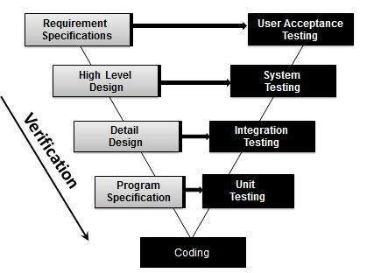
Verification Testing - Workflow:

Slide 7
Methods of Verification : Static Testing
Walkthrough
Inspection
Review

Slide 8
Validation (ARE WE BUILDING THE RIGHT PRODUCT?)
Definition: The process of evaluating software during or at the end of the development process to determine whether it satisfies specified requirements.
Validation is the process of evaluating the final product to check whether the software meets the customer expectations and requirements.
It is a dynamic mechanism of validating and testing the actual product.

Slide 9
Methods of Validation : Dynamic Testing
Testing according to End Users
Validation testing can be best demonstrated using V-Model. The Software/product under test is evaluated during this type of testing.
Activities:
Unit Testing
Integration Testing
System Testing
User Acceptance Testing

Slide 10
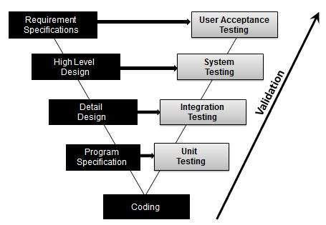
Validation Testing - Workflow:

Slide 11
Difference between Verification and Validation
The distinction between the two terms is largely to do with the role of specifications.
Verification is the process of checking that the software meets the specification.
Validation is the process of checking whether the specification captures the customer’s needs.
Verification is basically manually checking of the documents and files like requirement specifications etc.
Validation is basically checking of developed program based on the requirement specifications documents & files.

Slide 12
Difference between Verification and Validation
Verification |  | Validation
Verification is a static practice of verifying documents, design, code and program. |  | Validation is a dynamic mechanism of validating and testing the actual product.
It does not involve executing the code. |  | It always involves executing the code.
It is human based checking of documents and files. |  | It is computer based execution of program.

Slide 13
Verification is to check whether the software conforms to specifications. |  | Validation is to check whether software meets the customer expectations and requirements.
Target is requirements specification, application and software architecture, high level, complete design, and database design etc. |  | Target is actual product-a unit, a module, a bent of integrated modules, and effective final product.
Verification is done by QA team to ensure that the software is as per the specifications in the SRS document. |  | Validation is carried out with the involvement of testing team.

Slide 14
It generally comes first-done before validation. |  | It generally follows after verification.
Are we building the system right? |  | Are we building the right system?
Verification is the process of evaluating products of a development phase to find out whether they meet the specified requirements. |  | Validation is the process of evaluating software at the end of the development process to determine whether software meets the customer expectations and requirements.

Slide 15
The objective of Verification is to test that product being develop is as per the requirements and design specifications. |  | The objective of Validation is to test that product actually meet up the user’s requirements, and check whether the specifications were correct initially.
Following activities are involved in Verification: Reviews, Meetings and Inspections. |  | Following activities are involved in Validation: Testing like black box testing, white box testing, gray box testing etc.
Verification is carried out by QA team. |  | Validation is carried out by testing team.

Slide 16
It can catch errors that validation cannot catch. It is low level exercise. |  | It can catch errors that verification cannot catch. It is High Level Exercise.
Execution of code is not comes under Verification. |  | Execution of code is comes under Validation.
Verification is carried out before the Validation. |  | Validation activity is carried out just after the Verification.

Slide 17
Verification process explains whether the outputs are according to inputs or not. |  | Validation process describes whether the software is accepted by the user or not.
Following items are evaluated during Verification: Plans, Requirement Specifications, Design Specifications, Code, Test Cases etc, |  | Following item is evaluated during Validation: Actual product or Software under test.
Cost of errors caught in Verification is less than errors found in Validation. |  | Cost of errors caught in Validation is more than errors found in Verification.

Slide 18
Thank You!

